Slide 1
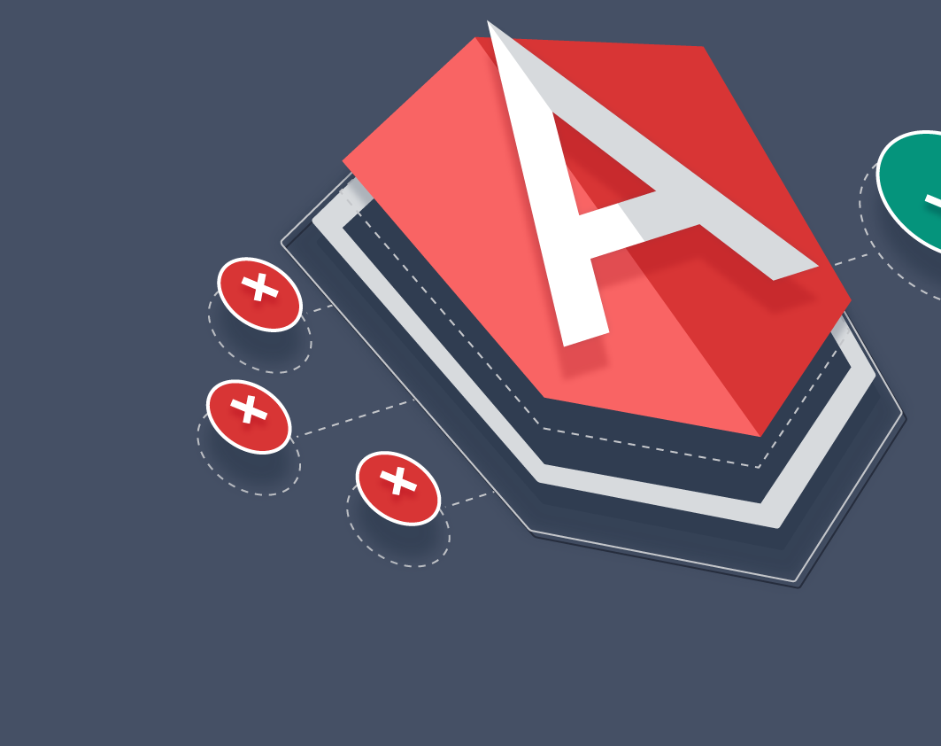
Angular: an overview
By
A. Sarveswara Reddy

Slide 2

AGENDA
Introduction to Angular
Why do we need angular?
Single Page Application(SPA)
Versions of angular
Features of Angular
Advantages
Applications
Conclusion

Slide 3

Introduction to Angular
Angular is an open-source framework for building client applications HTML, CSS and TypeScript, maintained by google.
Angular includes:
A component-based framework for building scalable web applications.
A collection of well-integrated libraries that cover a wide variety of features, including routing, forms management, client-server communication, and more.
A suite of developer tools to help you develop, build, test, and update your code.

Slide 4

Why do we need Angular?
Angular framework boosts web development efficiency and performance by providing a consistent structure so that developers don’t have to keep rebuilding code from scratch.
It is a time saver that offers developers a host of extra features that can be added to software without requiring extra effort.
It provides two-way data binding unlike other frameworks.

Slide 5
Single page Application(SPA)
Angular uses the concept of Single Page Application(SPA).
Single-page applications (SPAs) are web applications that load a single HTML page and dynamically update that page as the user interacts with the application. It doesn't need to make requests for new pages on server
SPAs use Ajax and HTML5 to create a fluid and responsive Web applications, without constant page reloads.

Slide 6
Versions of Angular
Angular1 (Angular Js)
Angular 2
Angular 3
Angular 12
…

Slide 7
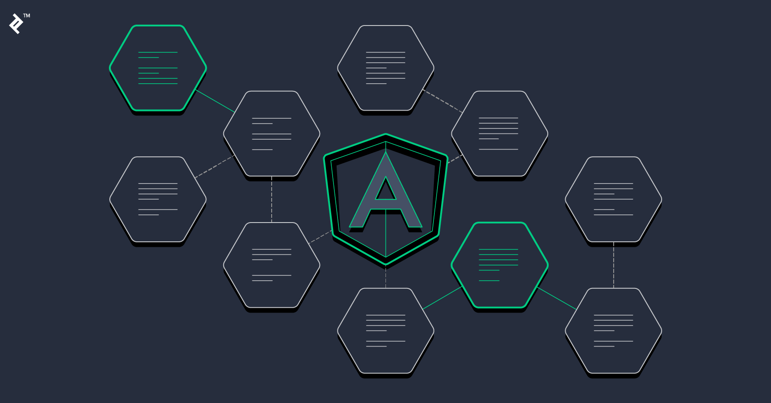
Features of Angular
Document Object Model (DOM)
TypeScript
Data Binding
Testing – Jasmine testing Framework
Modules
Components
Templates
Metadata
Directives

Slide 8
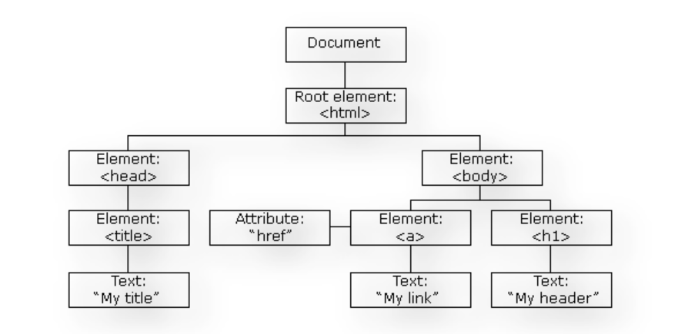
Document Object Model (DOM)
DOM (Document Object Model) treats an XML or HTML document as a tree structure in which each node represents a part of the document.
Angular uses regular DOM. Consider that ten updates are made on the same HTML page. Instead of updating the ones that were already updated, Angular will update the entire tree structure of HTML tags.

Slide 9
TypeScript
TypeScript defines a set of types to JavaScript, which helps users write JavaScript code that is easier to understand.
All of the TypeScript code compiles with JavaScript and can run smoothly on any platform.
TypeScript is not compulsory for developing an Angular application.
However, it is highly recommended as it offers better syntactic structure—while making the codebase easier to understand and maintain.
You can install TypeScript as an NPM package with the following command:
npm install -g typescript

Slide 10
Data Binding
Data binding is a process that enables users to manipulate web page elements through a web browser.
It employs dynamic HTML and does not require complex scripting or programming.
Data binding is used in web pages that include interactive components, such as calculators, tutorials, forums, and games.
It also enables a better incremental display of a web page when pages contain a large amount of data.
Angular uses the two-way binding. The model state reflects any changes made in the corresponding UI elements. Conversely, the UI state reflects any changes in the model state.
This feature enables the framework to connect the DOM to the model data through the controller.

Slide 11
Testing
Angular uses the Jasmine testing framework. The Jasmine framework provides multiple functionalities to write different kinds of test cases.
Karma is the task-runner for the tests that uses a configuration file to set the start-up, reporters, and testing framework.
Now that you’re familiar with Angular’s basic features, you need to understand its architecture if you want to work with Angular daily.

Slide 12
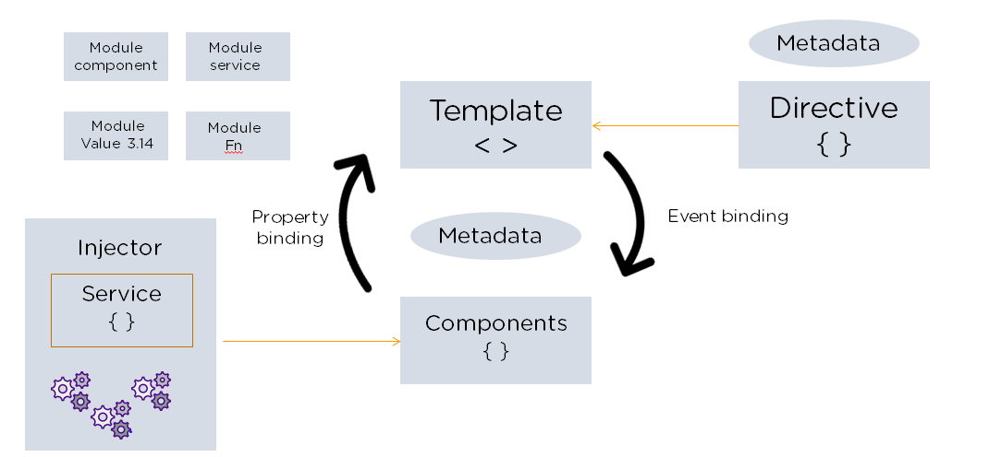
Angular Architecture
Angular is a full-fledged model-view-controller (MVC) framework.
It provides clear guidance on how the application should be structured and offers bi-directional data flow while providing real DOM.

Slide 13
The following are the eight building blocks of an Angular application:
1. Modules
An Angular app has a root module, named AppModule, which provides the bootstrap mechanism to launch the application.
2. Components
Each component in the application defines a class that holds the application logic and data. A component generally defines a part of the user interface (UI).
3. Templates
The Angular template combines the Angular markup with HTML to modify HTML elements before they are displayed. There are two types of data binding:
Event binding: Lets your app respond to user input in the target environment by updating your application data.

Slide 14
2. Property binding: Enables users to interpolate values that are computed from your application data into the HTML.
4. Metadata
Metadata tells Angular how to process a class. It is used to decorate the class so that it can configure the expected behavior of a class.
5. Services
When you have data or logic that isn’t associated with the view but has to be shared across components, a service class is created. The class is always associated with the @Injectible decorator.
6. Dependency Injection
This feature lets you keep your component classes crisp and efficient. It does not fetch data from a server, validate the user input, or log directly to the console. Instead, it delegates such tasks to the services.

Slide 15
AngularJS Directives
AngularJS directives extend the HTML by providing it with new syntax. You can easily spot directives because they have the prefix “ng-.” Consider them markers on the DOM element, instructing AngularJS to attach a certain behavior to the element, or even change it outright.
Here are two sample directives:
The ng-model Directive
The ng-model binds the value of the HTML control with the specified AngularJS expression value.
The ng-bind Directive
This directive replaces the HTML control value with a specified AngularJS expression value.

Slide 16
Advantages
Time saving
Data binding
Single page application
Material design like Interface
Better error handling
Speed and performance

Slide 17
Advantages of Angular
Many versions of Angular have been released since its inception. All these versions have added to the efficient working of the framework.
1. Custom Components
Angular enables users to build their own components that can pack functionality along with rendering logic into reusable pieces. It also plays well with web components.
2. Data Binding
Angular enables users to effortlessly move data from JavaScript code to the view, and react to user events without having to write any code manually.
3. Dependency Injection
Angular enables users to write modular services and inject them wherever they are needed. This improves the testability and reusability of the same services.

Slide 18
Advantages of Angular
4. Testing
Tests are first-class tools, and Angular has been built from the ground up with testability in mind. You will have the ability to test every part of your application—which is highly recommended.
5. Comprehensive
Angular is a full-fledged framework and provides out-of-the-box solutions for server communication, routing within your application, and more.
6. Browser Compatibility
Angular is cross-platform and compatible with multiple browsers. An Angular application can typically run on all browsers (Eg: Chrome, Firefox) and OSes, such as Windows, macOS, and Linux.

Slide 19
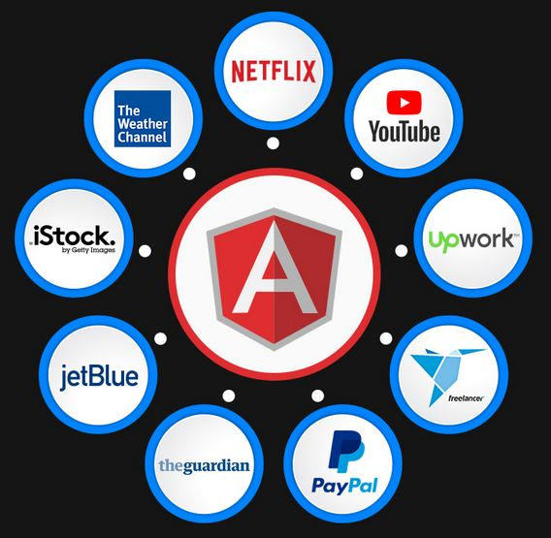
Applications

Slide 20

Conclusion
Angular is an open-source, JavaScript framework written in TypeScript. It enables users to develop and test large applications easily.
It has surpassed Javascript for developing single-page applications that require modularity, testability, and developer productivity.
Angular supports frameworks lke CSS and bootstrap for frontend.

Slide 21

Thank you

